Slide 1



HHS 2025-2026 Robotics Season DECODE
By Alistair Taylor, Flynn Lambley, Elijah Sutton, Miles Clarke, Lilly Salter, Benjamin Hosey, Toby Parrish
Team 21126

Slide 2
Meet the team:
Team 21126

Slide 3
Alistair: Programmer
Brief: Upskilled programming language to java from blocks.
Programmed drivetrain, left, right, diagonal, forward, backwards motion.
Programmed flywheel launcher and “artefact gate” servo.
Programmed distance sensor and camera.
Miles –Project Manager
Brief: Program and design consultant responsible for ensuring that the group stays on task and there is always a cross pollination of ideas and gracious professionalism and drafting and producing our final engineering portfolio.
Lilly – Design and Construction
Brief: Update drivetrain.
Design and build scaffolding/support for flywheel launcher and ramp.
Team 21126

Slide 4
Elijah: Design and Construction
Brief: Update drivetrain.
Design and build scaffolding/support for flywheel launcher and ramp.
Flynn: Output designer
Brief: Update drivetrain.
Design and build scaffolding/support for flywheel launcher and ramp.
Benjamin: Advisor and Support
Brief: Critically analyse design and construction.
Team 21126

Slide 5
Holmfirth high robotics
The team has been in place since 2019 and successfully competed at York stem centre, placing third in the regional competition. We have competed twice at the midlands regional competition in 2022 and 23 and currently compete in the Yorkshire regionals at Hallam university.
Each year the team is made up of a number of students from year 7 to 11 with the majority of them in years 10 and 11. In 2025, we were able to enter two teams.
Team 21126

Slide 6
The Robot
Summary:
The robot is built up in three parts:
Drivetrain
Artefact Launcher/gate
Remote Sensing
In addition, programming
Team 21126

Slide 7
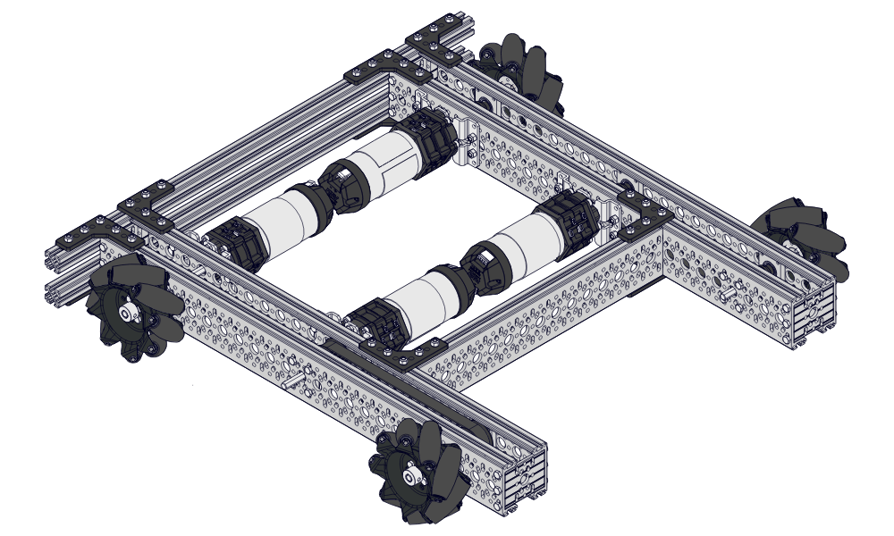
Drivetrain
Our current drivetrain is two years old. Initially made from extruded aluminium t slots, we were able to get a grant from our Parent Teacher Association to buy a number of c channels and planetary motors and omnidirectional wheels. The current drivetrain is built around the design of the Meccanum drivetrain kit with 90 degree boxes enabling the motors to sit inside the c channels for a more compact design.
Team 21126

Slide 8
Drivetrain
Improvements:
Team 21126

Slide 9
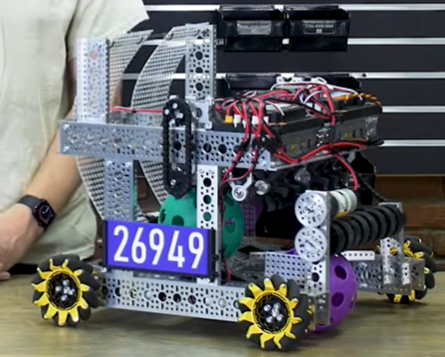
Artefact launcher
Design and construction team
Research:
https://www.youtube.com/watch?v=wp4r___y_O4
Team 21126

Slide 10
Programming
Alistair Taylor
Team 21126

Slide 11

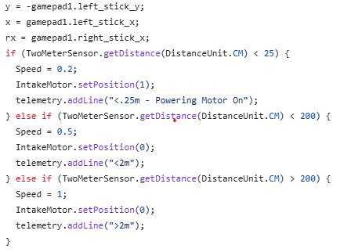
Drive
Our robot is split into two sections: the drive & the launcher section.
First, the drive section, the code to the left is responsible for the driving of the omni directional robot. This allows the robot to move in all four directions as well as diagonally and pivot on the spot.
This next screenshot shows the code weuseto stop the motors when we are too close to an object.
Confusingly, the Back Left motor is reversed.

Slide 12
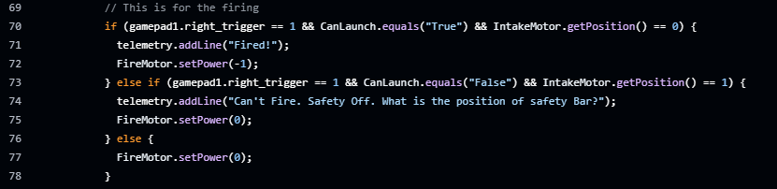
Launcher
Secondly, the launcher:
This code is responsible for activating the firing motor when a trigger is pressed and turning it off if not.

